Slide 1
3. Perceptron and ADALINE
3.1 Perceptron neuron
3.2 Perceptron learning rule
3.3 Perceptron network
3.4 ADALINE
3.5 LMS learning rule
3.6 ADALINE network
3.7 ADALINE vs. Perceptron
3.8 Adaptive filtering
3.9 XOR problem
3.10 MATLAB Live Script examples

Slide 2
Introduction
Pioneering neural network contributions
McCulloch & Pits (1943) – the idea of neural networks as computing machines
Rosenblatt (1958) – proposed perceptron as the first supervised learning model
Widrow and Hoff (1961) – least-mean-square learning as an important generalization of perceptron learning
Perceptron
Layer of McCulloch-Pits neurons with adjustable synaptic weights
The simplest form of a neural network for classification of linearly separable patterns
Perceptron convergence theorem for two linearly separable classes
ADALINE
Similar to perceptron, trained with least-mean-square (LMS) learning rule
Used for linear adaptive filters

Slide 3
3.1 Perceptron neuron
Perceptron neuron (McCulloch-Pits neuron): hard-limit (threshold) activation function
Perceptron output: 0 or 1 → useful for classification
If y=0 → pattern belongs to class A
If y=1 → pattern belongs to class B
Notes:
van der Smagt, p.23
Explain: perceptron neuron is a neuron with hard-limit activation function.

Slide 4
Linear discriminant function
Perceptron with two inputs
Separation between the two classes is a straight line, given by
Geometric representation
Perceptron represents a linear discriminant function

Slide 5
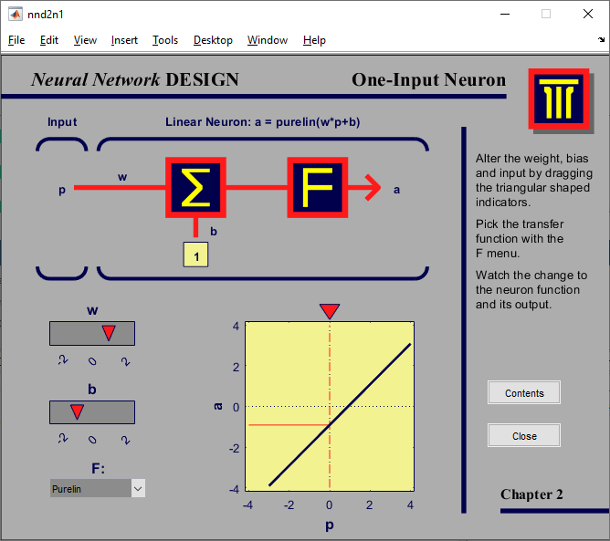
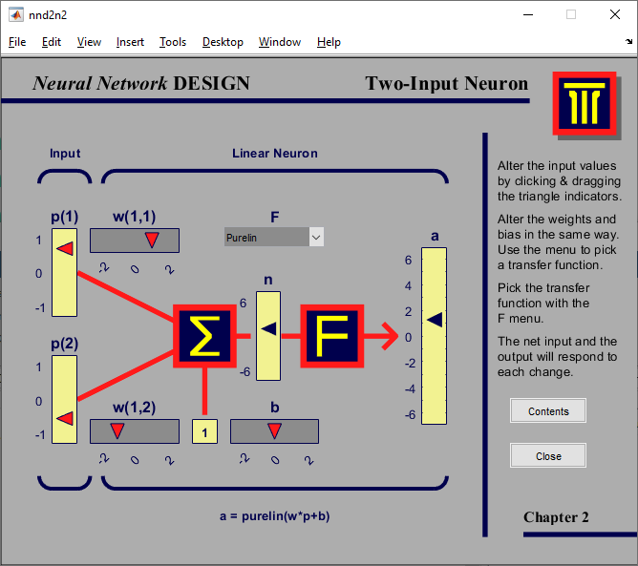
MATLAB demos (Perceptron)
Run built-in commands in MATLAB:
>> nnd2n1 % Single input perceptron
>> nnd2n2 % Two-input perceptron

Slide 6
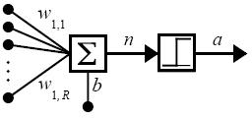
How to train a perceptron?
How to train weights and bias?
Perceptron learning rule
Least-mean-square learning rule or “delta rule”
Both are iterative learning procedures
A learning sample is presented to the network
For each network parameter, the new value is computed by adding a correction
Formulation of the learning problem
How do we compute Δw(t) and Δb(t) to classify the learning patterns correctly?

Slide 7
3.2 Perceptron learning rule
A set of learning samples (inputs and target classes)
Objective:
Reduce error e between target class d and neuron response y
(error-correction learning)
e = d - y
Learning procedure
Start with random weights for the connections
Present an input vector x_{i} from the set of training samples
If perceptron response is wrong: y≠d, e≠0, modify all connections w
Go back to 2
Notes:
Inputs are real numbers, outputs are binary

Slide 8
Three conditions for a neuron
After the presentation of input x, the neuron can be in three conditions:
CASE 1: If neuron output is correct, weights w are not altered
CASE 2: Neuron output is 0 instead of 1 (y=0, d=1, e=d-y=1) Input x is added to weight vector w
This makes the weight vector point closer to the input vector, increasing the chance that the input vector will be classified as 1 in the future.
CASE 3: Neuron output is 1 instead of 0 (y=1, d=0, e=d-y=-1) Input x is subtracted from weight vector w
This makes the weight vector point farther away from the input vector, increasing the chance that the input vector will be classified as a 0 in the future.

Slide 9
Three conditions rewritten
Three conditions for a neuron rewritten
CASE 1: e = 0 → Δw = 0
CASE 2: e = 1 → Δw = x
CASE 3: e = -1 → Δw = -x
Three conditions in a single expression
Δw = (d-y)x = ex
Similar for the bias
Δb = (d-y)(1) = e
Perceptron learning rule

Slide 10
Convergence theorem
For the perceptron learning rule there exists a convergence theorem:
Theorem 1 If there exists a set of connection weights w which is able to perform the transformation d=y(x), the perceptron learning rule will converge to some solution in a finite number of steps for any initial choice of the weights.
Limitations and comments
Theorem is only valid for linearly separable classes
Outliers can cause long training times
If classes are linearly separable, perceptron offers a powerful pattern recognition tool

Slide 11
Perceptron learning rule summary
Start with random weights for the connections w
Select an input vector x from the set of training samples
If perceptron response is wrong: y≠d, modify all connections according to the learning rule:
Go back to 2 (until all input vectors are correctly classified)
Notes:
Demonstrate the perceptron learning rule with MATLAB built-in demos (next slide).

Slide 12
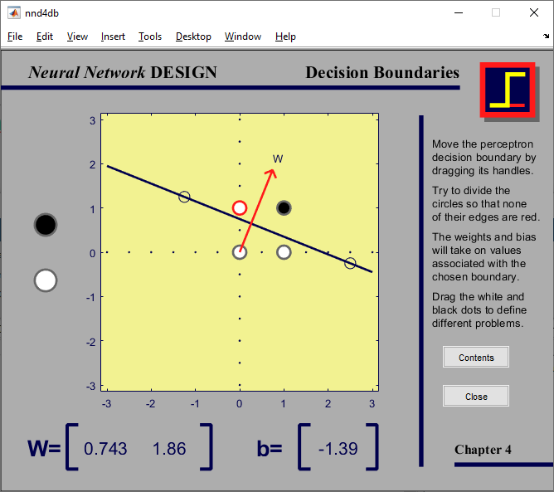
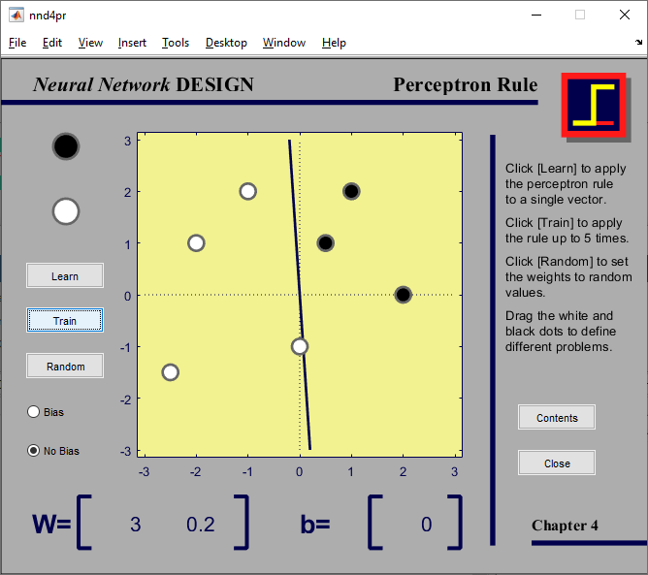
MATLAB demos (Perceptron)
Run built-in commands in MATLAB:
>> nnd4db % Decision boundaries
>> nnd4pr % Perceptron rule

Slide 13
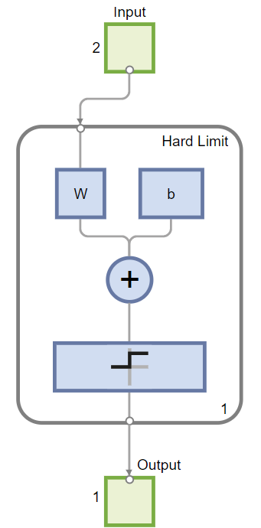
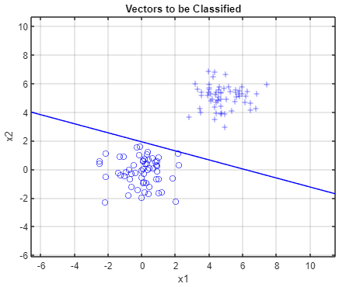
MATLAB Live Script example
NN3b_Perceptron.mlx
Classification of linearly separable data with a perceptron

Slide 14
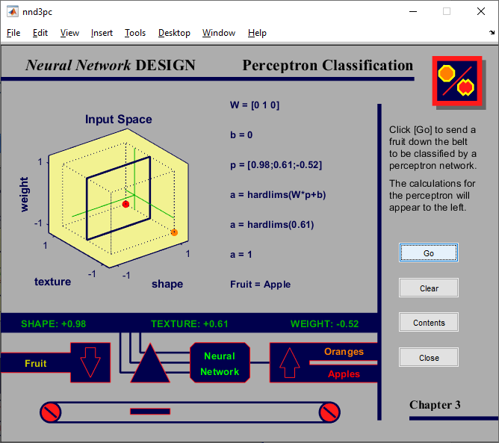
MATLAB demo (Classification application)
Run built-in command in MATLAB:
>> nnd3pc % Perceptron classification fruit example

Slide 15
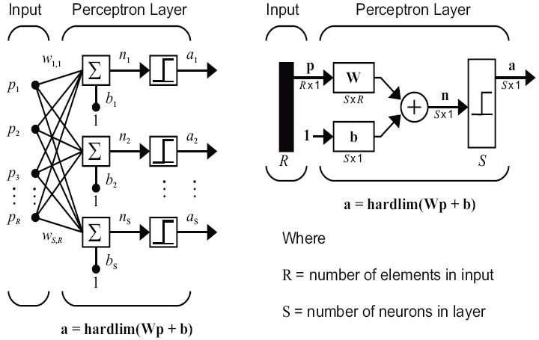
3.3 Perceptron network
Single layer of perceptron neurons
Classification in more than two linearly separable classes

Slide 16
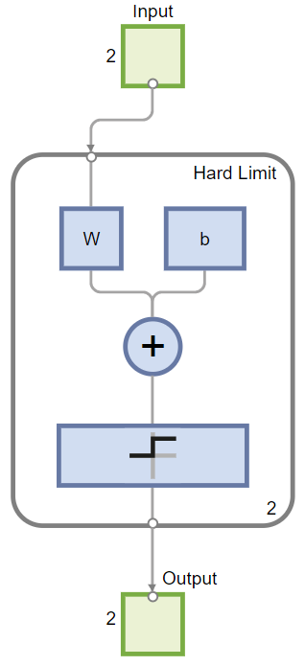
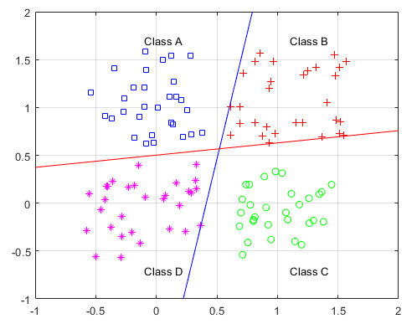
MATLAB Live Script example
NN3c_Perceptron_network.mlx
Classification of a 4-class problem with a perceptron network

Slide 17
3.4 ADALINE
ADALINE = Adaptive Linear Element
Widrow and Hoff, 1961: LMS learning (Least Mean Square) or Delta rule
Important generalization of perceptron learning rule
Main difference with perceptron → activation function
Perceptron: Threshold activation function
ADALINE: Linear activation function
Both Perceptron and ADALINE can only solve linearly separable problems

Slide 18
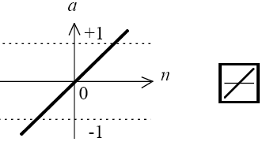
Linear neuron
Basic ADALINE element
Linear transfer function

Slide 19
Simple ADALINE
Simple ADALINE with two inputs
Like a perceptron, ADALINE has a decision boundary
defined by network inputs for which network output is zero
see Perceptron decision boundary
ADALINE can be used to classify objects into categories

Slide 20
3.5 LMS learning rule
LMS = Least Mean Square learning rule
A set of learning samples (inputs and target classes)
Objective: reduce error e between target class d and neuron response y (error-correction learning)
e = d – y
Goal is to minimize the mean squared error

Slide 21
LMS algorithm (1/3)
LMS algorithm is based on approximate steepest descent procedure
Widrow & Hoff introduced the idea to estimate mean-square-error
by using square-error at each iteration
and change network weights proportional to the negative derivative of the error
with some learning constant η

Slide 22
LMS algorithm (2/3)
Now we expand the expression for weight change ...
Expanding the neuron activation y(n)
and using the cosmetic correction
we finally obtain the weight change at step n

Slide 23
LMS algorithm (3/3)
Final form of LMS learning rule
Learning is regulated by a learning rate η
Stable learning → learning rate η must be less than the reciprocal of the largest eigenvalue of the correlation matrix x^{T}x of input vectors
Limitations
Linear network can only learn linear input-output mappings
Proper selection of learning rate η

Slide 24
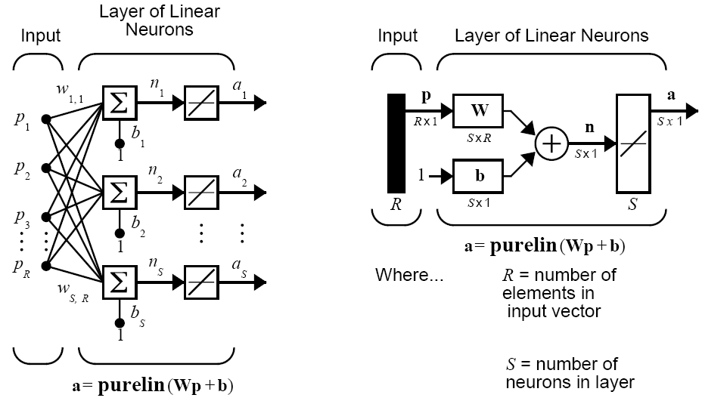
3.6 ADALINE network
ADALINE network = MADALINE (single layer of ADALINE neurons)
Notes:
Explain: M stands for „multi“ and refers to the multi-dimensional output of a single layer of ADALINE neurons.
https://uk.mathworks.com/help/deeplearning/ug/adaptive-neural-network-filters.html
Notice that MADALINE can also refer to a multilayer network which is a more advanced case:
https://en.wikipedia.org/wiki/ADALINE#MADALINE

Slide 25
3.7 ADALINE vs. Perceptron
Architectures
Learning rules
LMS learning Perceptron learning
ADALINE PERCEPTRON

Slide 26
ADALINE and Perceptron summary
Single-layer networks can be built based on ADALINE or Perceptron neurons
Both architectures are suitable to learn only linear input-output relationships
Perceptron with threshold activation function is suitable for classification problems
ADALINE with linear output is more suitable for regression & filtering
ADALINE is suitable for continuous learning

Slide 27
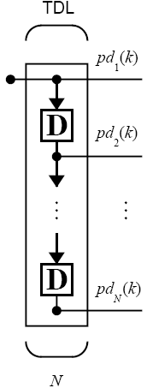
3.8 Adaptive filtering
ADALINE is one of the most widely used neural networks in practical applications
Adaptive filtering is one of its major application areas
We introduce the new element: Tapped delay line
Input signal enters from the left and passes through N-1 delays
Output of the tapped delay line (TDL) is an N-dimensional vector, composed of current and past inputs
Input

Slide 28
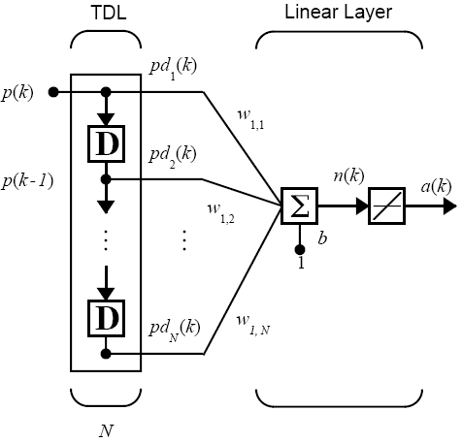
Adaptive filter
Adaptive filter = ADALINE combined with TDL

Slide 29
Simple adaptive filter example
Adaptive filter with three delayed inputs

Slide 30
Adaptive filter for prediction
Adaptive filter can be used to predict the next value of a time series p(t+1)
Now
Learning
Operation
p(t-2) p(t-1) p(t) p(t+1) Time
p(t-2) p(t-1) p(t) p(t+1) Time
Learning

Slide 31
Noise cancellation example
Adaptive filter can be used to cancel engine noise in the pilot’s voice in an airplane
The goal is to obtain a signal that contains the pilot’s voice, but not the engine noise.
Linear neural net is adaptively trained to predict the combined pilot/engine signal m from an engine signal n. Only engine noise n is available to the network, so it only learns to predict the engine’s contribution to the pilot/engine signal m.
The network error e becomes equal to the pilot’s voice. The linear adaptive network adaptively learns to cancel the engine noise.
Such adaptive noise canceling generally does a better job than a classical filter because the noise here is subtracted from rather than filtered out of the signal m.

Slide 32
Single-layer adaptive filter network
If more than one output neuron is required, a tapped delay line can be connected to a layer of neurons

Slide 33
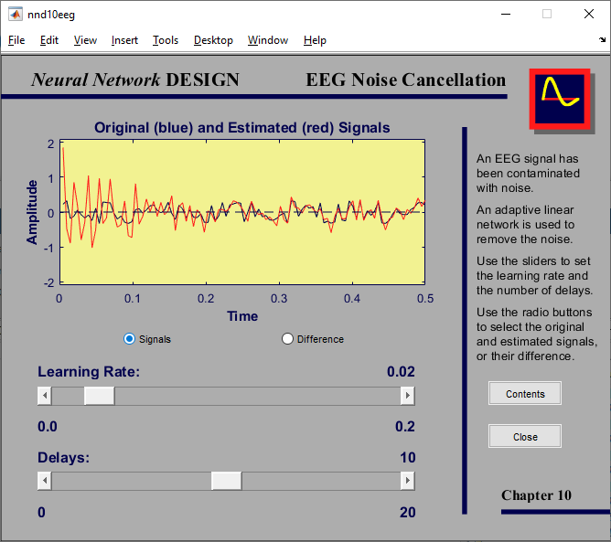
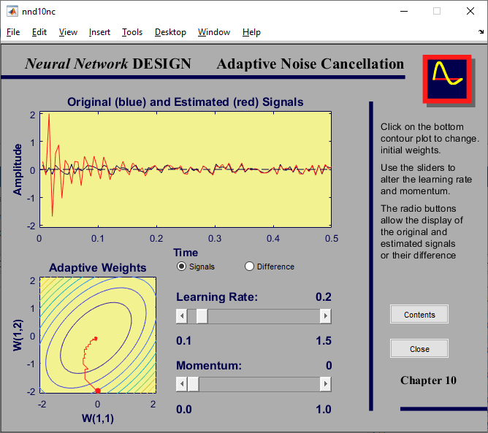
MATLAB demos (ADALINE)
Run built-in commands in MATLAB:
>> nnd10eeg % ADALINE for noise filtering of EEG signals
>> nnd10nc % Adaptive noise cancelation

Slide 34
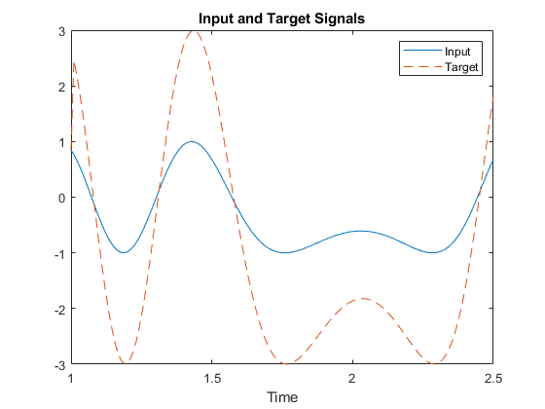
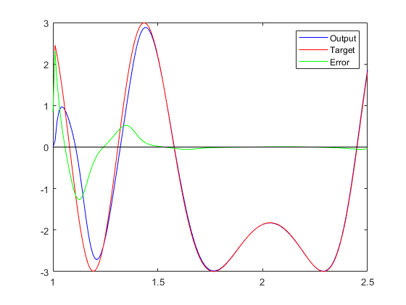
MATLAB Live Script demo (ADALINE)
Run built-in commands in MATLAB:
>> openExample('nnet/demolin8') % Adaptation of a linear neuron
Adaptation

Slide 35
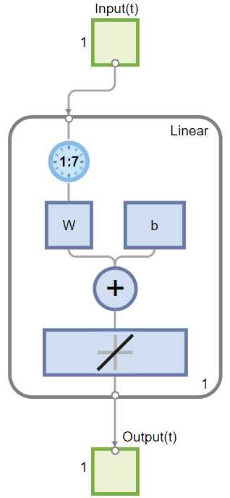
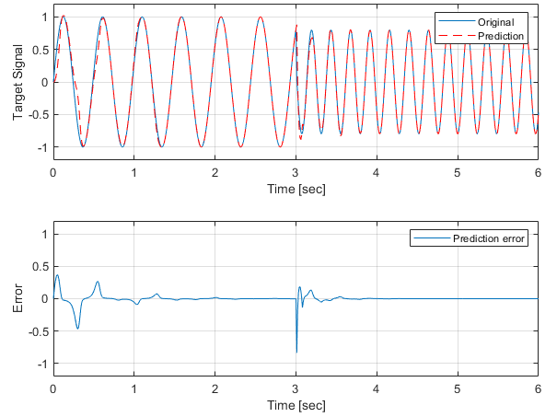
MATLAB Live Script example
NN3c_Adaline.mlx
Construct an ADALINE for adaptive prediction of time series based on past time series data

Slide 36
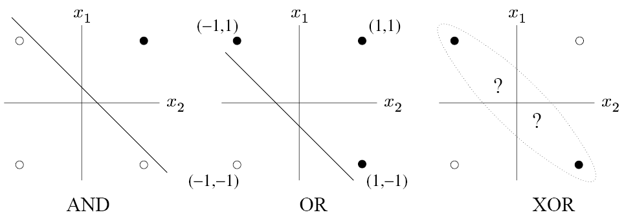
3.9 XOR problem
Single-layer perceptron cannot represent XOR function
One of Minsky and Papert’s most discouraging results
Example: perceptron with two inputs
Only AND and OR functions can be represented by Perceptron
Discriminant function

Slide 37
XOR solution
Extending single-layer perceptron to multi-layer perceptron by introducing hidden units
XOR problem can be solved but we no longer have a learning rule to train the network
Multilayer perceptrons can do everything → How to train them?

Slide 38
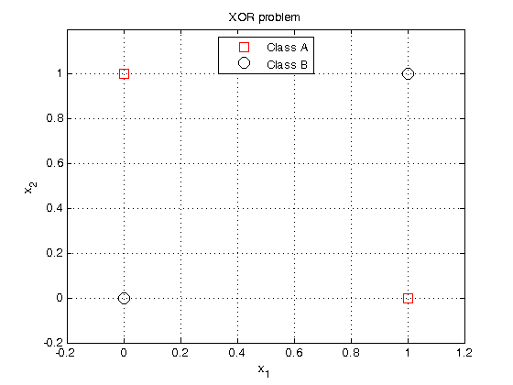
Homework
Create a two-layer perceptron to solve the XOR problem
Create a custom network
Demonstrate solution
Notes:
Suggestions for the solution:
Create two perceptrons, each dividing the space in either x1 or x2 axis
Encode outputs of perceptrons as 0 | 1, then combine outputs into [ 0,0; 0,1; 1,0; 1,1]
Solutions [0,0] and [1,1] correspond to class B, and solutions [0,1] and [1,0] correspond to class A

Slide 39
3.10 MATLAB Live Script examples
NN3a_Perceptron.mlx
Two clusters of data, belonging to two classes, are defined in 2-dimensional input space. Classes are linearly separable. The task is to construct a Perceptron for the classification of data.
NN3b_Perceptron_network.mlx
Perceptron network with 2-inputs and 2-outputs is trained to classify input vectors into 4 categories.
NN3c_Adaline.mlx
Construct an ADALINE for adaptive prediction of time series based on past time series data

